Slide 1
AI-Based Desktop Voice Assistant
Dr. U.Chaitanya
Internal Supervisor
Dr. U.Chaitanya
IOMP Supervisor
IOMP ID:IT-25-26
-By
B.V.Mohan Karthik - 22261A1207
P.Sindhuja - 22261A1243

Slide 2

MAHATMA GANDHI INSTITUTE OF TECHNOLOGY(A)
DEPARTMENT OF INFORMATION TECHNOLOGY
An Industry Oriented Mini Project(IT653PC)
On
AI BASED DESKTOP VOICE ASSISTANT
By
B.V.Mohan Karthik(22261A1207)
P.Sindhuja(22261A1243) Batch ID: IT-25-26
Internal Supervisor
Dr. U. Chaitanya Assistant Professor
IOMP Supervisor
Dr.U.Chaitanya Assistant Professor

Slide 3
Index
Abstract
Introduction
Existing System
Proposed System
Application
Requirements
Literature Survey
Problem Statement
Objective of Project
Modules Description
Algorithm/Model/
Design
13. Code Execution
14.Test Cases
15. Conclusion and Future Enhancement
16. References

Slide 4
Abstract
A Desktop Voice Assistant is a software application that allows users to interact with their desktop computers through voice commands instead of traditional input methods like keyboard or mouse. It uses speech recognition, Natural Language Processing (NLP), and Artificial Intelligence (AI) to understand, interpret, and execute user commands.
This AI-driven voice assistant functions as an intelligent system capable of managing multiple tasks such as file administration, internet browsing, email handling, multimedia control, and system operations. The assistant utilizes NLP and Automatic Speech Recognition (ASR) to accurately understand and execute user commands. Additionally, machine learning algorithms enhance the assistant’s ability to improve its accuracy and responsiveness over time, adapting to user preferences and behavioral patterns.

Slide 5
Introduction
With the increasing dependence on computers and automation, there is a growing need for more intuitive and accessible ways to interact with technology. Traditional input methods like keyboard and mouse can be limiting, especially in multitasking environments or for users with physical impairments. Voice-controlled assistants offer a hands-free, efficient solution by enabling natural communication between users and machines.
This project presents an AI-Based Desktop Voice Assistant that utilizes Natural Language Processing (NLP) to accurately understand and respond to user voice commands. It can perform tasks such as opening applications, browsing the internet, managing emails, retrieving information, and controlling system settings. Designed to enhance productivity, accessibility, and user convenience, the assistant provides an intelligent and adaptive interface tailored for modern desktop usage.

Slide 6
Existing System
Traditional desktop interaction depends on keyboard and mouse, limiting hands-free accessibility.
Voice assistants like Cortana, Google Assistant, and Siri are primarily designed for mobile or cloud platforms.
These assistants offer limited desktop application integration and lack custom task automation features for desktops.
Continuous internet connectivity is often required, reducing offline functionality.
Current solutions are not optimized for desktop-specific workflows or multitasking needs.
Accessibility for users with physical impairments is still restricted with existing systems.

Slide 7
Proposed System
The system is an AI-based Desktop Voice Assistant for smart and hands-free interaction with computers.
Uses Automatic Speech Recognition (ASR) and Natural Language Processing (NLP) to interpret voice commands accurately.
Incorporates Machine Learning to adapt to user behavior, preferences, and frequently used commands.
Capable of performing tasks such as:
File management
Web browsing
Email handling
Multimedia control
System operations
Supports both online and offline functionalities for greater flexibility.
Offers personalized command handling for better user experience.
Ensures seamless integration with desktop applications.
Designed to improve productivity, accessibility, and user convenience in desktop environments.

Slide 8
Applications of AI Voice Assistant
For Professionals – Helps automate daily tasks like scheduling meetings, sending emails, and browsing the internet.
For Students – Aids in research, Wikipedia searches, and document management.
For People with Disabilities – Offers hands-free computer navigation for improved accessibility.
For General Users – Provides convenience by executing voice commands efficiently.

Slide 9
Hardware Requirements
Processor: Intel Core i5 or higher
RAM: Minimum 8GB
Storage: At least 20GB free space
Microphone: High-quality microphone for accurate speech recognition
Speakers: For audio output and voice responses.
GPU (Optional): Dedicated GPU (NVIDIA/AMD) for AI model acceleration.
Internet Connection: Required for cloud-based speech recognition APIs.

Slide 10
Software Requirements
Operating System:Windows 10/11
Programming Language:Python 3.8+
Development Environment:Jupyter Notebook / VS Code / PyCharm.
React.js
HTML,CSS,JavaScript
Speech Recognition API
Natural Language Processing APIs
Text to Speech API
Web & Knowledge APIs

Slide 11
LITERATURE SURVEY
S.No. | Author Names and Year of Publication | Journal or Conference Name and Publisher | Methodology/Algorithm/ Techniques Used | Merits | Demerits | Research Gaps
1. | Yuqi Huang, 2023 | SHS Web of Conferences, SDMC 2022 | Natural Language Processing (NLP), AI Integration | Provides a comprehensive view on voice assistant development in the AI era. | Focused on general voice assistant systems, not desktop-specific. | More focus needed on desktop-oriented voice assistant optimization and offline operation.
2. | P. Kunekar, A. Deshmukh, S. Gajalwad, A. Bichare, K. Gunjal, S. Hingade, 2023 | 5th Biennial International Conference on Nascent Technologies in Engineering (ICNTE) | AI-based Speech Recognition, NLP, Desktop Assistant Architecture | Discusses AI-based desktop assistants specifically, contributing to desktop environment improvements. | May not integrate seamlessly with existing desktop applications | Need for better integration with diverse desktop applications and offline support.
3. | S. Gowroju, S. Kumar, S. Choudhary, 2024 | 7th International Conference on Contemporary Computing and Informatics (IC3I) | NLP-driven Voice Recognition, Contextual Understanding | Improves desktop interaction with voice recognition by focusing on NLP-driven systems. | Limited to specific use cases, may not scale to general desktop environments. | Further research on broad multi-platform support and adaptive learning.
4. | S. Alharbi et al., 2021 | IEEE Access | Automatic Speech Recognition (ASR), Systematic Literature Review | Thorough review of existing speech recognition systems and their capabilities. | Focused mainly on the technical aspects of speech recognition. | Lack of specific focus on desktop integration and voice assistant performance in real-world use.
5. | R. Benny, A. Muralidharan, M. Subramanian, 2024 | Second International Conference on Emerging Trends in Information Technology and Engineering (ICETITE) | OpenAI-based voice assistants, Machine Learning, Performance Evaluation | Use of OpenAI for improved interaction and AI-driven enhancements for voice assistants. | May require a stable internet connection, not ideal for offline environments. | More research needed on offline performance, adaptive learning in real-world desktop use cases.

Slide 12
Problem Statement
Despite rapid advancements in user interface technologies, desktop users still rely primarily on traditional input methods like the keyboard and mouse. These methods limit hands-free interaction, reduce efficiency, and hinder accessibility, especially for users with physical challenges or those performing multiple tasks. Existing voice assistants are often tailored for mobile platforms and require constant internet access, offering minimal integration with desktop systems and lacking support for offline functionality.
There is a clear need for a dedicated AI-based Desktop Voice Assistant that can ensure accurate speech recognition, deliver context-aware responses, and automate common tasks such as file management, system control, and application launching. It should also provide adaptive behavior based on user preferences and work efficiently in both online and offline environments. Such a solution would bridge the gap in accessibility, productivity, and user convenience in modern desktop computing.

Slide 13
Objectives
Utilizing Natural Language Processing (NLP) to understand and process user instructions effectively.
Enabling execution of tasks such as file management, web browsing, email operations, multimedia control, and other system-level actions.
Providing offline support to ensure usability without continuous internet connectivity.

Slide 14
Modules Description
Speech Recognition Module
1.Captures voice input from the user.
2.Converts speech to text
Natural Language Processing (NLP)
1.Analyzes the text input.
2.Extracts intent and identifies commands.
Command Execution
1.Maps recognized commands to desktop actions.
2.Executes tasks such as file management, system operations, web browsing, etc.
Machine Learning
1.Adapts based on user behavior and usage patterns.
2.Enhances recognition accuracy and personalization over time.

Slide 15
MODEL
Microphone Module Captures the user's voice input with real-time audio sensing capability.
ASR (Automatic Speech Recognition) Module Converts spoken language into text using a speech-to-text engine.
NLP (Natural Language Processing) Unit Processes the text to identify user intent and extracts actionable commands.
Command Processor Matches recognized commands against a predefined task database.
Execution Unit Interfaces with the operating system or external APIs to perform the required action.
Feedback Module Delivers confirmation or response through audio output or visual display.
Learning Module Logs user interactions and uses machine learning techniques to improve accuracy and personalization over time.

Slide 16
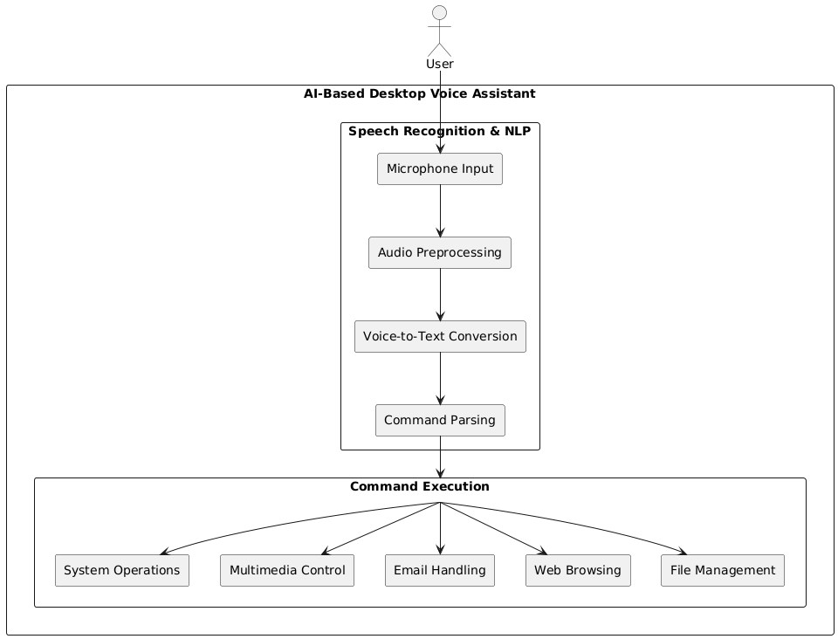
Architecture

Slide 17
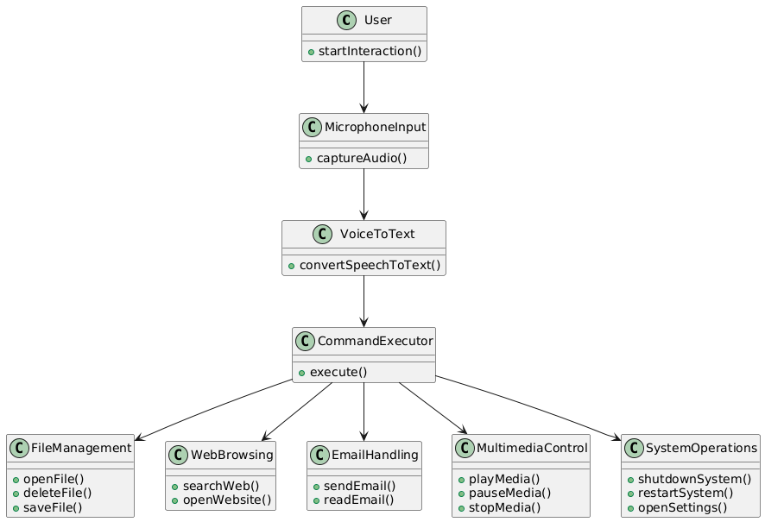
UML Diagrams
Class Diagram

Slide 18
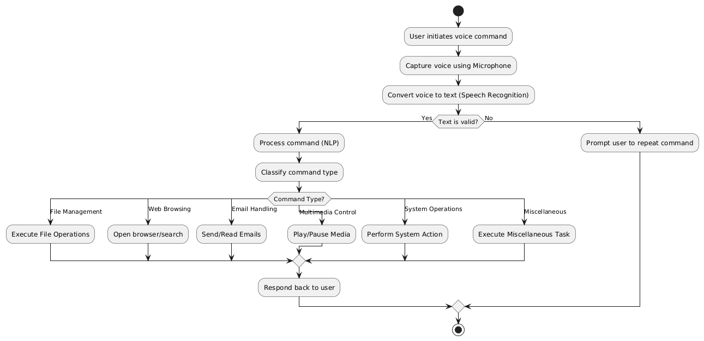
Activity Diagram

Slide 19
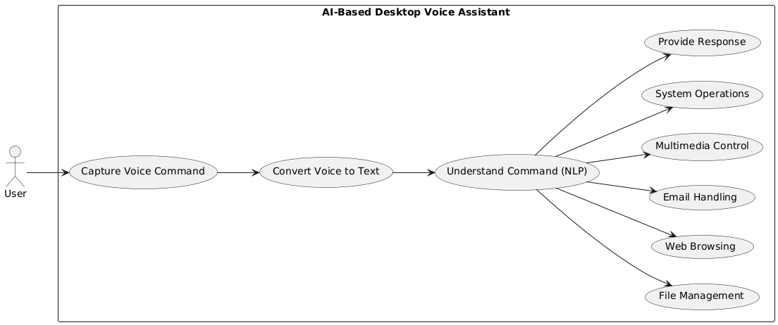
Use Case Diagram

Slide 20
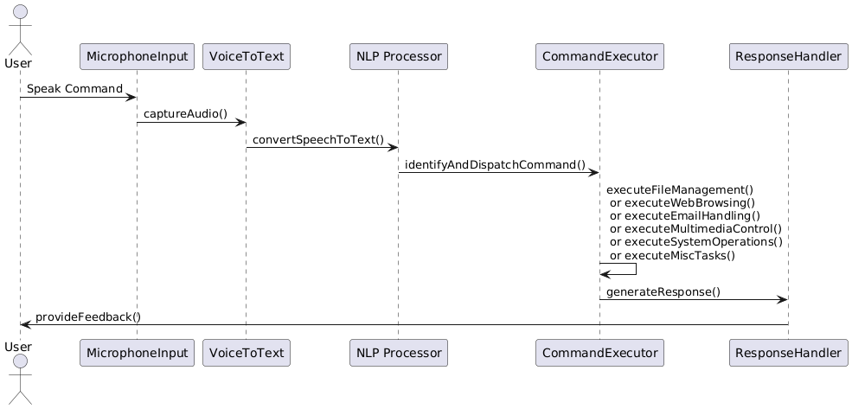
Sequence Diagram

Slide 21
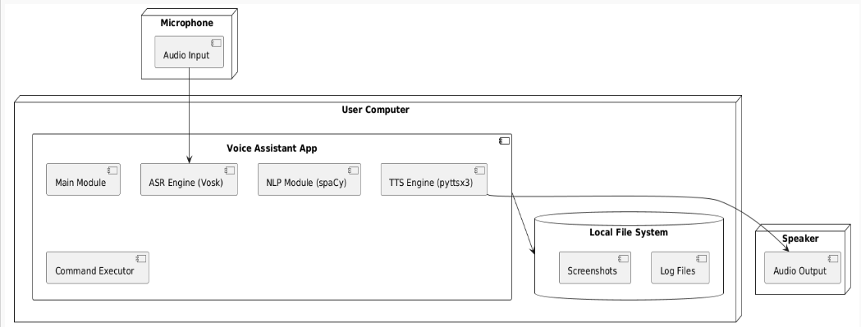
Deployment Diagram

Slide 22
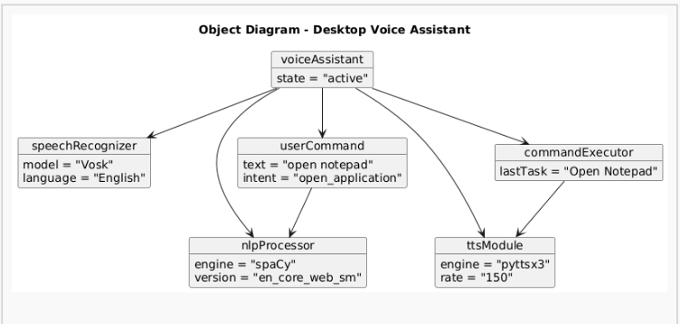
Object Diagram

Slide 23
TESTCASES
Test Case ID | Test Case Name | Test Description | Expected Output | Actual Output | Remarks
TC_01 | Initial Page | Verify if the application loads the initial home or welcome screen correctly | Initial screen with logo and start button is displayed | Initial screen loaded successfully | Success
TC_02 | Date & Time | Test if the system correctly detects and logs current date and time from the device | Current system date and time are auto-filled in the form | Date and time detected and shown correctly | Success
TC_03 | Wikipedia | Check if clicking on the "Learn More" button opens relevant Wikipedia information | Wikipedia page opens in a new browser tab/window | Wikipedia article opened as expected | Success
TC_04 | Youtube | Test if YouTube video content related to health or fitness is embedded/linked | Health-related video loads and plays without buffering issues | Video loaded and played smoothly | Success
TC_05 | Offline Songs | Verify if songs or audio play without internet connection | Audio files should play from local storage | Songs played correctly in offline mode | Success
TC_06 | Searching in Google | Test if voice or text-based search opens Google search results | Google search results shown based on user query | Google search executed and results displayed | Success
TC_07 | Screenshot | Check if the app allows users to take a screenshot of their current dashboard | Screenshot is saved to gallery or a specified folder | Screenshot captured and saved correctly | Success
TC_08 | Going Offline | Validate if the app notifies or handles functionality when device goes offline | "You're Offline" message shown and offline features enabled | Offline message displayed; essential features accessible offline | Success

Slide 24
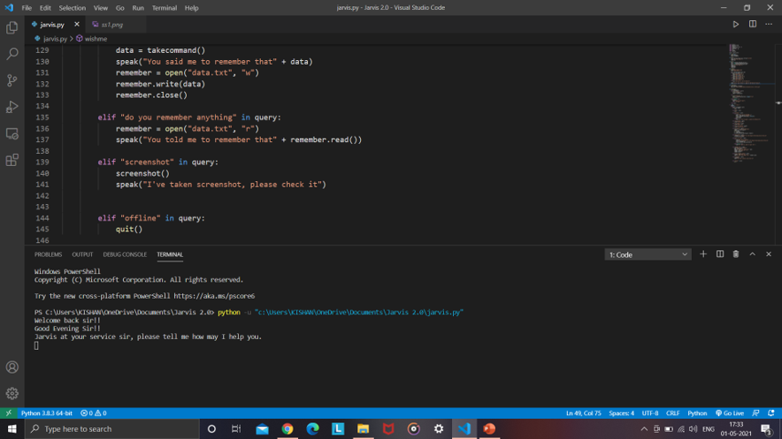
CODE EXECUTION & RESULT
INITIAL PAGE

Slide 25
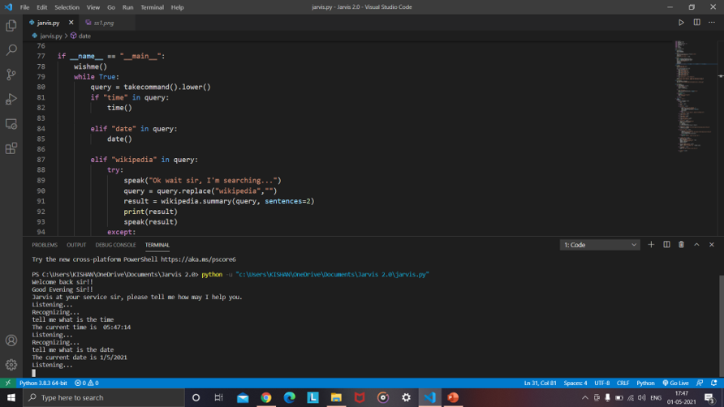
DATE & TIME

Slide 26
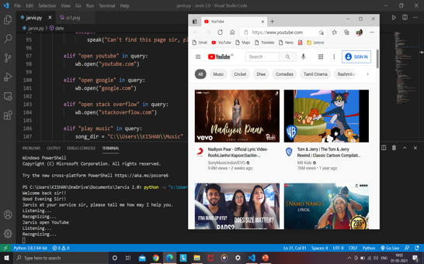
YOUTUBE

Slide 27
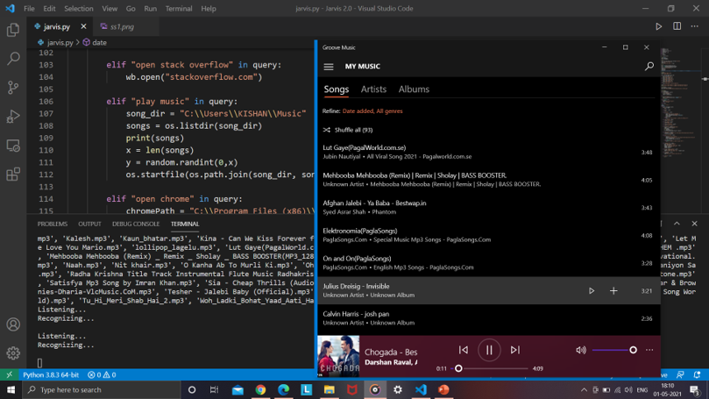
OFFLINE SONGS

Slide 28
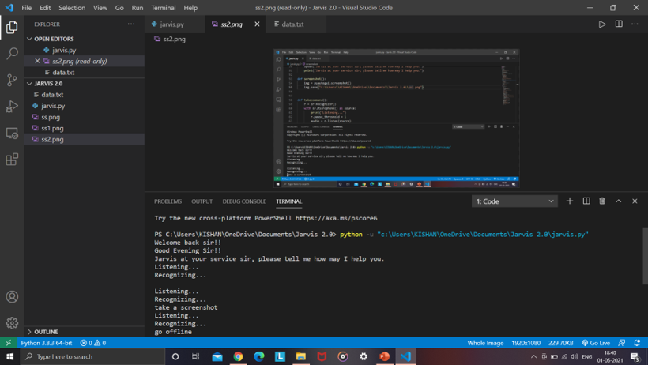
SCREENSHOT

Slide 29
Conclusion & Future Scope
The AI Desktop Voice Assistant project effectively showcases the integration of voice recognition, intelligent command processing, and personalized interaction to enhance user convenience and productivity. By capturing voice inputs and leveraging NLP for intent detection, the system enables users to perform a wide range of tasks—such as opening applications, searching the web, setting reminders, and retrieving information—through simple natural language command.
This AI assistant can be further enhanced with:
Machine Learning Algorithms for personalized responses.
Multi-platform support.
Smart Home Integration for controlling IoT devices.
Conversational AI improvements for a more interactive user experience.

Slide 30
References:
[1] Yuqi HuangBeijing Etown Academy, No.12 Sihe Road. Daxing District. Beijing, China.” Research on the Development of Voice Assistants in the Era of Artificial Intelligence “SHS Web of Conferences 155, 03019 (2023) https://doi.org/10.1051/shsconf/202315503019 SDMC 2022
[2] P. Kunekar, A. Deshmukh, S. Gajalwad, A. Bichare, K. Gunjal and S. Hingade, "AI-based Desktop Voice Assistant," 2023 5th Biennial International Conference on Nascent Technologies in Engineering (ICNTE), Navi Mumbai, India, 2023, pp. 1-4, doi: 10.1109/ICNTE56631.2023.10146699.
[3] S. Gowroju, S. Kumar and S. Choudhary, "Natural Language Processing-Driven Voice Recognition System for Enhancing Desktop Assistant Interactions," 2024 7th International Conference on Contemporary Computing and Informatics (IC3I), Greater Noida, India, 2024, pp. 1136-1141, doi: 10.1109/IC3I61595.2024.10829162.
[4] S. Alharbi et al., "Automatic Speech Recognition: Systematic Literature Review," in IEEE Access, vol. 9, pp. 131858- 131876, 2021, doi: 10.1109/ACCESS.2021.3112535.
[5] R. Benny, A. Muralidharan and M. Subramanian, "OpenAI-Enhanced Personal Desktop Assistant: A Revolution in Human- Computer Interaction," 2024 Second International Conference on Emerging Trends in Information Technology and Engineering (ICETITE), Vellore, India, 2024, pp. 1-7, doi: 10.1109/ic-ETITE58242.2024.10493339.

